Slide 1
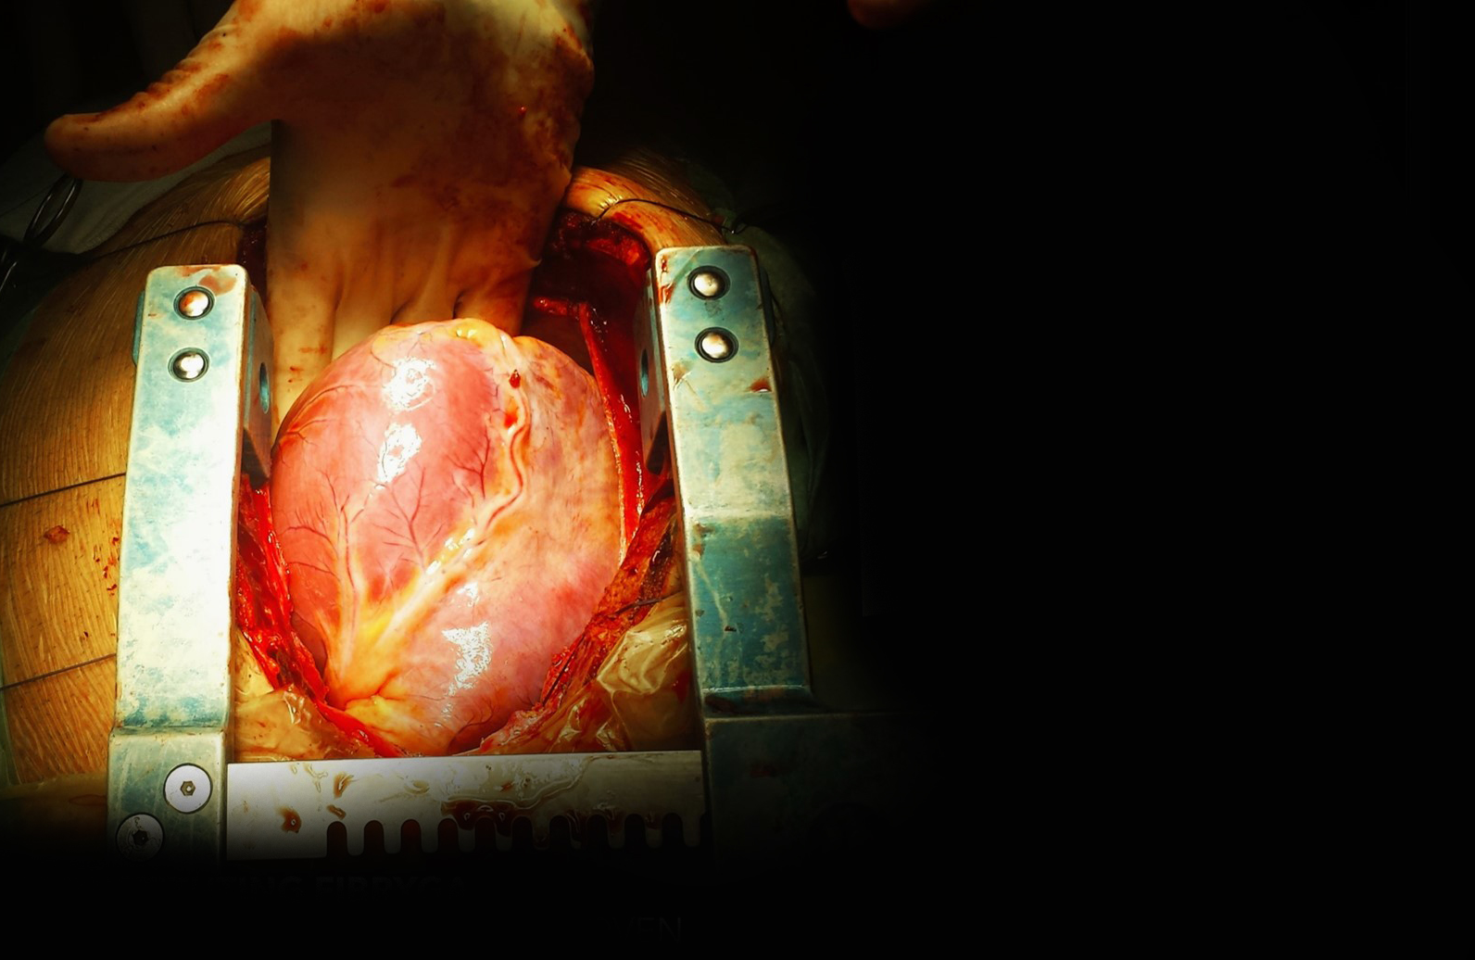
Critical evidence in critical situations
The first and only fibrinogen replacement therapy in Canada with an extensive clinical program supporting its new indication as a complementary therapy during the management of uncontrolled severe bleeding in patients with acquired fibrinogen deficiency in the course of surgical interventions¹
1. Fibryga® Product Monograph. Octapharma Canada Inc. July 16, 2020.
Notes:
*Using the Octajet® transfer device for reconstitution, and average reconstitution time of 0.4:27 ± 0.3:37 min was achieved (mean value ± SD of 87 determination performed by 25 participants)¹
Schulz P et al. Biochemical characterization, stability and pathogen safety of a new fibrinogen concentrate (Fibryga®). Biologicals 2017; https://doi.org/10.1016/j.biologicals.2017.12.0031.

Slide 2
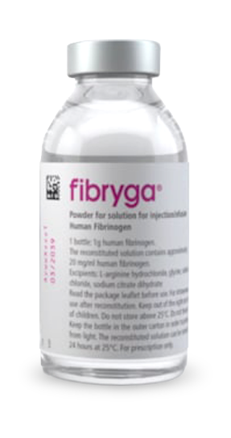
NEW AFD INDICTION
2
Fibryga® is now the first and only fibrinogen replacement therapy in Canada
NOW
FIRST
& ONLY
IN CANADA
Indicated as a complementary therapy during the management of uncontrolled severe bleeding in patients with acquired fibrinogen deficiency in the course of surgical interventions¹
Fibryga® is also indicated for the treatment of acute bleeding episodes and perioperative prophylaxis in adult and pediatric patients with congenital afibrinogenemia and hypofibrinogenemia.¹
1. Fibryga® Product Monograph. Octapharma Canada Inc. July 16, 2020.
Confidential
1. Fibryga® Product Monograph. Octapharma Canada Inc. July 16, 2020.

Slide 3
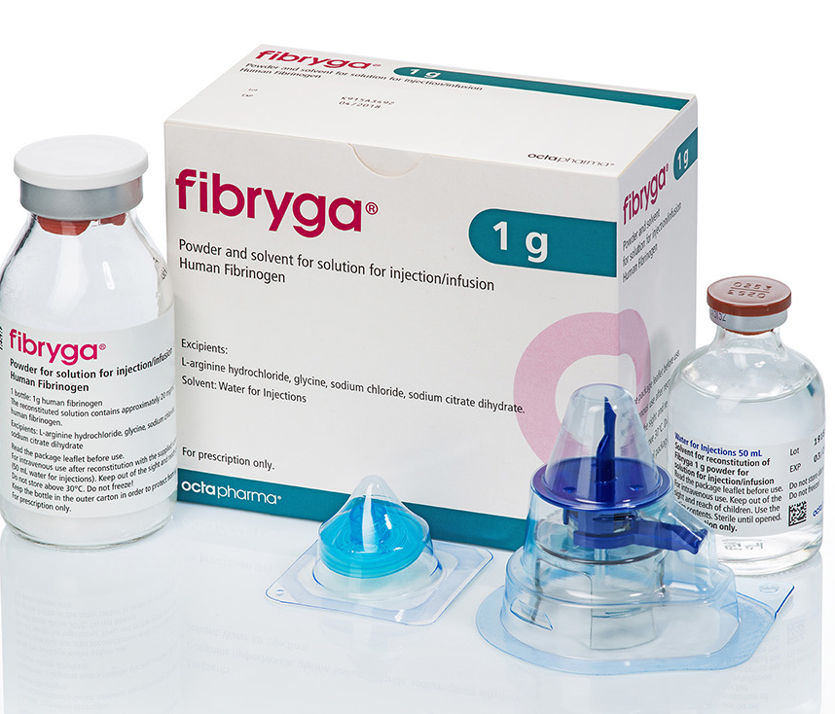
NEW Co-Packaging
3
Fibryga® is now conveniently co-packaged with water for injection (WFI)
Co-package allows for traceability and convenient reconstitution of Fibryga®. One product code allows for simpler inventory management, ordering, and delivery to the OR/floor.
^{AVAILABLE NOW IN CANADA}
Fibryga® is also indicated for the treatment of acute bleeding episodes and perioperative prophylaxis in adult and pediatric patients with congenital afibrinogenemia and hypofibrinogenemia.¹
1. Fibryga® Product Monograph. Octapharma Canada Inc. July 16, 2020.
Confidential
1. Fibryga® Product Monograph. Octapharma Canada Inc. July 16, 2020.

Slide 4
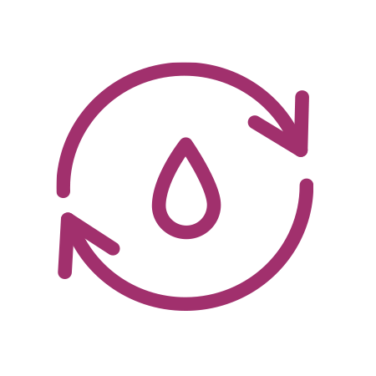
ABOUT Fibryga
Fibryga® is a fibrinogen concentrate designed for efficacy, safety and ease of use¹
Double viral inactivated
Highly-purified human fibrinogen concentrate (FC)
Higher purity and fibrinogen activity
Fast to reconstitute and use
* Under ideal conditions with a trained professional.
† Unless the method of opening/reconstitution precludes the risk of microbial contamination, Fibryga® should be used immediately.
‡ During the management of uncontrolled severe bleeding in the course of surgical interventions for patients with acquired fibrinogen deficiency.
1. Fibryga® Product Monograph. Octapharma Canada Inc. July 16, 2020.

Slide 5
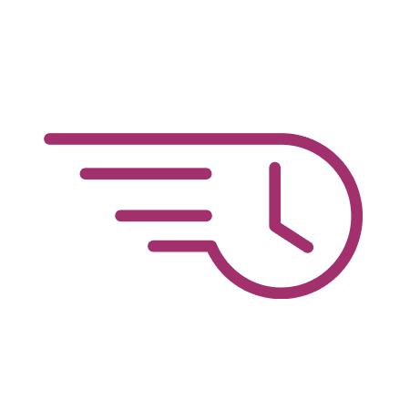
ABOUT Fibryga
Fibryga® is a fibrinogen concentrate designed for efficacy, safety and ease of use¹
Easy to store and handle
The most extensively-studied FC with a robust clinical program
Faster infusion speed
* Under ideal conditions with a trained professional.
† Unless the method of opening/reconstitution precludes the risk of microbial contamination, Fibryga® should be used immediately.
‡ During the management of uncontrolled severe bleeding in the course of surgical interventions for patients with acquired fibrinogen deficiency.
1. Fibryga® Product Monograph. Octapharma Canada Inc. July 16, 2020.

Slide 6
CURRENT STATE OF CARE
Fibryga® advances the current state of research and care in AFD with clinical evidence and demonstrated outcomes
CRYOPRECIPITATE^{1,2}
OLDER (2nd-generation) FC³
FIBRYGA^{®4}
30–45 min. to prepare
Variable fibrinogen content
Not purified
Not virally inactivated
Requires blood type matching
Stored frozen, and discarded after 4 hours once thawed if unused
5–10 min. to reconstitute
Not highly purified, contains albumin Single virus inactivation
No clinical evidence or indication in AFD
Stored refrigerated, and discarded after 8 hours if unused once reconstituted*
~5 min. to reconstitute
Highly purified, no albumin Double virus inactivation
Robust clinical program and indication as a complementary therapy in AFD
Stored refrigerated or at room temperature, and stable for
24 hours at room temperature once reconstituted†
VS
VS
* Reconstituted product should be used immediately.
† Unless the method of opening/reconstitution precludes the risk of microbial contamination, Fibryga® should be used immediately.
Notes:
Note: blood type is no longer required for cryo (though may still be needed for peds)- June 2019 (Dr. Pavinsky, St. Mikes)

Slide 7
Comparison of Fibrinogen Concentrates
Differences in the biochemical composition of plasma derived human fibrinogen concentrates¹
 | Fibryga® 4g (n=22) | Cryoprecipitate 2 pools (10 U) (n=23)
Fibrinogen Antigen (g) | 3.0 | 3.3
Fibronectin (mg) | 2.1 | 140
VWF Antigen (U) | 30 | 570
FXIII Activity (U) | 585 | 165
Fibryga® 4g
Other Available FC
Lower fibronectin and VWF antigen may contribute to increased safety, and higher FXIII levels may contribute to increased efficacy
Note: based on in vitro studies
Fibryga® is a registered trademark of Octapharma Canada Inc. All other trademarks are property of their respective owners. Copyright © 2020 Octapharma Canada Inc.

Slide 8
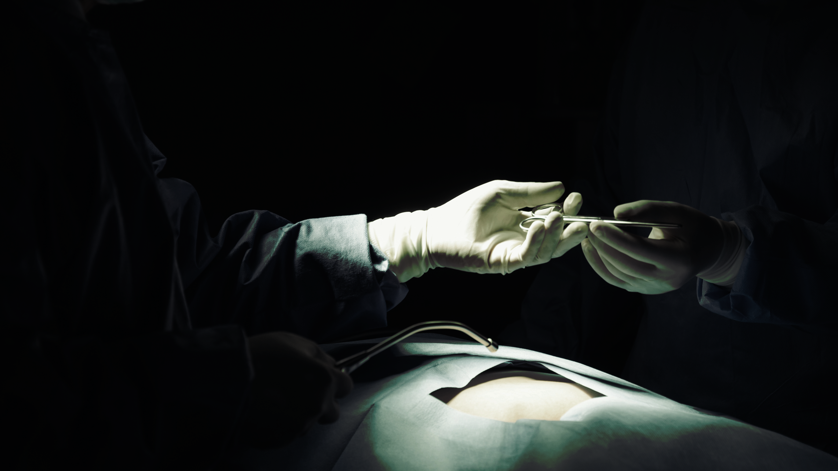
The Fibryga® Clinical Program
in CFD and AFD
Compelling evidence in cardiac and abdominal surgeries involving significant blood loss
1. Fibryga® Product Monograph. Octapharma Canada Inc. July 16, 2020.

Slide 9
The Fibryga® clinical program*
Extensively studied in both CFD and AFD
CFD
FORMA-01
FORMA-02
FORMA-04
Phase II, comparative, pharmacokinetic (PK) study vs. RiaSTAP®.³
Phase III safety and efficacy study for
on-demand treatment of bleeds and for preventing bleeding in surgery.⁴
Phase IIIb study to evaluate the efficacy and safety in acute surgical bleeding in children and adolescents (aged <12 years).⁵
COMPLETED
COMPLETED
COMPLETED
Notes:
independent data monitoring and endpoint adjudication committee (IDMEAC)

Slide 10
The Fibryga® clinical program*
Extensively studied in both CFD and AFD
AFD
FIBRES
FORMA-05
Phase IIIb
non-inferiority study comparing Fibryga® to cryoprecipitate in cardiac surgery.¹
AFD
Prospective, randomized, controlled phase II pilot study on efficacy in Pseudomyxoma Peritonei (PMP).²
COMPLETED
COMPLETED
* Clinical significance has not been established.

Slide 11
Using Fibryga®
In your institution
Fast reconstitution and easy dosing for treatment convenience

Slide 12
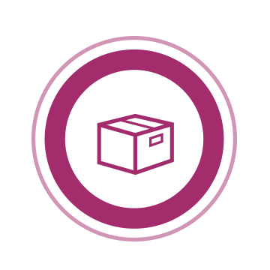
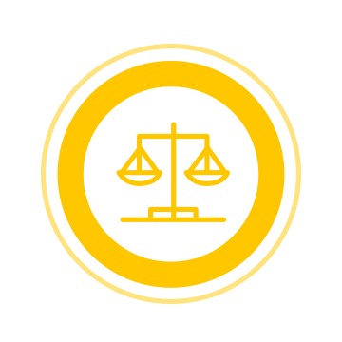
Fibryga®
Unparalleled ease of storage and handling¹
Storage
Shelf life
Stability
Room temperature or refrigerator
2–25°C
3 years
24 hours at room temperature
+25°C*
* Unless the method of opening/reconstitution precludes the risk of microbial contamination, Fibryga® should be used immediately.

Slide 13
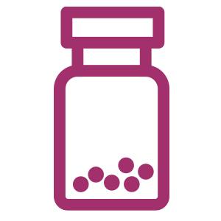
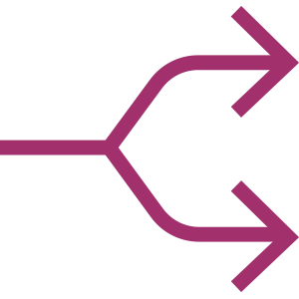
Fibryga®: Fast reconstitution and infusion¹
13
~5 minutes to reconstitute using the Octajet® transfer device*
DO
DO NOT
Use intravenous only.
Use solutions that are cloudy or have deposits
Infuse at 20 mL/min to deliver the full 4 g dose in only 10 minutes†
Use a separate intravenous line.
Mix with other medicinal products.
* Under ideal conditions with a trained professional.
† During the management of uncontrolled severe bleeding in the course of surgical interventions for patients with acquired fibrinogen deficiency.

Slide 14
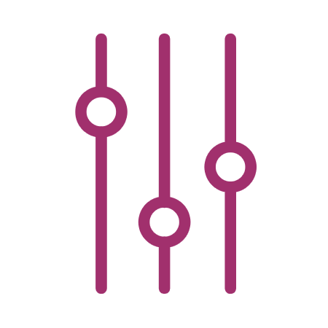
Dosing Fibryga®
in AFD¹
Initial Dose
Additional Doses
4g
4g
As needed when plasma Fibrinogen
<200 mg/dL or FIBTEM A10 <10mm*
Monitor the patient’s plasma fibrinogen level or the clot firmness of the fibrin-based clot during treatment with Fibryga®
Infusion speed 20 mL/min (max)
*Or equivalent values generated by other thromboelastometry/thromboelastography methods.
Notes:
Make recon tools a stand-alone tool with link to recon video and further tips slides
Move this up somewhere more prominent

Slide 15
Dosing Fibryga® in CFD¹
Recommended target plasma fibrinogen
Minor bleeding or minor surgery: 100mg/dL
Major bleeding or major surgery: 150 mg/dL
When baseline plasma fibrinogen is KNOWN
Dosing, duration of dosing and frequency of administration should be individualized based on the extent of bleeding, laboratory values, and the clinical condition of the patient.
When baseline plasma fibrinogen is UNKNOWN
[Target level (mg/dL) – Measured level (mg/dL)]
Dose
(mg/kg
body weight)
60 mg/kg body weight
1.8 (mg/dL per mg/kg body weight)
Infusion speed 5 mL/min (max)

Slide 16
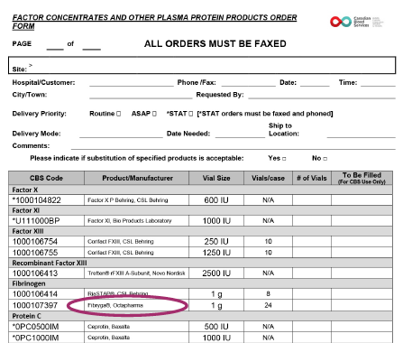
Fibryga® : THE NEW GENERATION OF FIBRINOGEN CONCENTRATE
Fibryga® now available through CBS product order form
Conveniently order Fibryga® using the CBS
Factor Concentrates and
Other Plasma Protein Products Order Form

Slide 17
FIBRYGA®: PACKAGE CONTENTS
What comes in your FIBRYGA® package?
Fibryga® Powder Vial
Octajet® Transfer Device
Particle Filter
Leaflet
Water for injection (WFI)
*Components used in Fibryga® packaging are latex-free

Slide 18
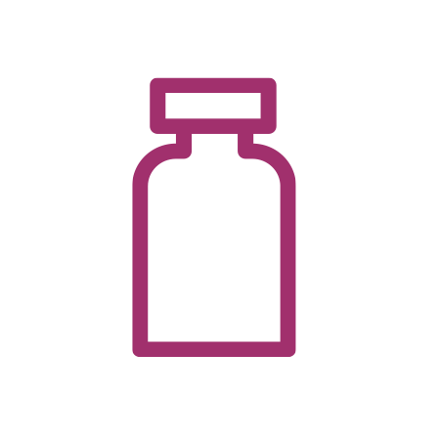
FibrygaResources.ca
A virtual tool kit for healthcare professionals
Introduction to Fibryga®
An overview of product information, administration, tools and resources.
Get everything you need online
Fibryga® reconstitution guide and video
Personalized help and resources
Request a virtual consult, in-person training, demo kits, or medical information.
Key publications
and customer letters
The latest information about Fibryga®

Slide 19
SUMMARY
Critical evidence in critical situations
Now indicated as a complementary therapy during the management of uncontrolled severe bleeding in patients with AFD in the course of surgical interventions¹
Exceptional product purity and safety
Highly-purified human fibrinogen concentrate (FC)¹
Double virus inactivated¹
Well-established safety and tolerability profile
No adverse events were considered to be related to Fibryga^{®1}
No thromboembolic adverse events in abdominal surgery patients³
A robust clinical program and compelling evidence in AFD^{2,3}
FIBRES²
FORMA-05³
Easy to store and handle
Lyophilized powder is stable at 2–25°C for up to 3 years
Reconstituted solution is stable for up to 24 hours at +25°C†
Demonstrated non-inferiority to cryoprecipitate in:
Cardiac surgery patients: Total and individual allogenic blood component units (red blood cells, platelets, and plasma) administered for 24 hours post-CPB^{1,2}
Abdominal surgery patients: Composite of intraoperative and postoperative hemostatic efficacy^{1,3}
Fast to reconstitute and use
Reconstitute in ~5 minutes* with just 50 mL of water for injection
Infuse at 20 mL/min to deliver the full 4 g dose in only 10 minutes‡
* Clinical significance has not been established.
† Under ideal conditions with a trained professional.
‡ Unless the method of opening/reconstitution precludes the risk of microbial contamination, Fibryga® should be used immediately.

Slide 20
Important safety information about Fibryga^{®1}
Indications and clinical use:
Fibryga® (Fibrinogen Concentrate [Human], 1 g/vial) is indicated for the treatment of acute bleeding episodes and perioperative prophylaxis in adult and pediatric patients with congenital afibrinogenemia and hypofibrinogenemia.
Fibryga® may be used as a complementary therapy during the management of uncontrolled severe bleeding in patients with acquired fibrinogen deficiency in the course of surgical interventions.
No data are available in patients below 12 years of age.
Fibryga® is a registered trademark of Octapharma Canada Inc. All other trademarks are property of their respective owners. Copyright © 2020 Octapharma Canada Inc.

Slide 21
Important safety information about Fibryga^{®1}
Relevant warnings and precautions:
Risk of infectious agents with products made from human plasma.
Risk of allergic reaction.
Patients should be monitored for risk of thrombosis.
Safety has not been established for use in human pregnancy. Benefits and risks to pregnant women should be carefully weighed.
Safety has not been established for use in nursing women. Should be given with caution.
Determination of the patient’s fibrinogen level using an appropriate method (e.g., Clauss fibrinogen assay) is recommended before and during the treatment to avoid overdosing or underdosing.
For more information:
Please consult the product monograph for important information relating to adverse reactions, drug interactions and dosing information which have not been discussed in this advertisement. The product monograph is also available by contacting Octapharma Canada Inc.
Fibryga® is a registered trademark of Octapharma Canada Inc. All other trademarks are property of their respective owners. Copyright © 2020 Octapharma Canada Inc.

